Slide 1
PROJECT REPORT - CENSUS DATASET
Imarticus - BAP-R-07
Vignesh M

Slide 2
Objective
To predict if a person’s income is more than $50,000 or less than $50,000
In order to predict we will be using classification techniques like logistic regression and random forest

Slide 3
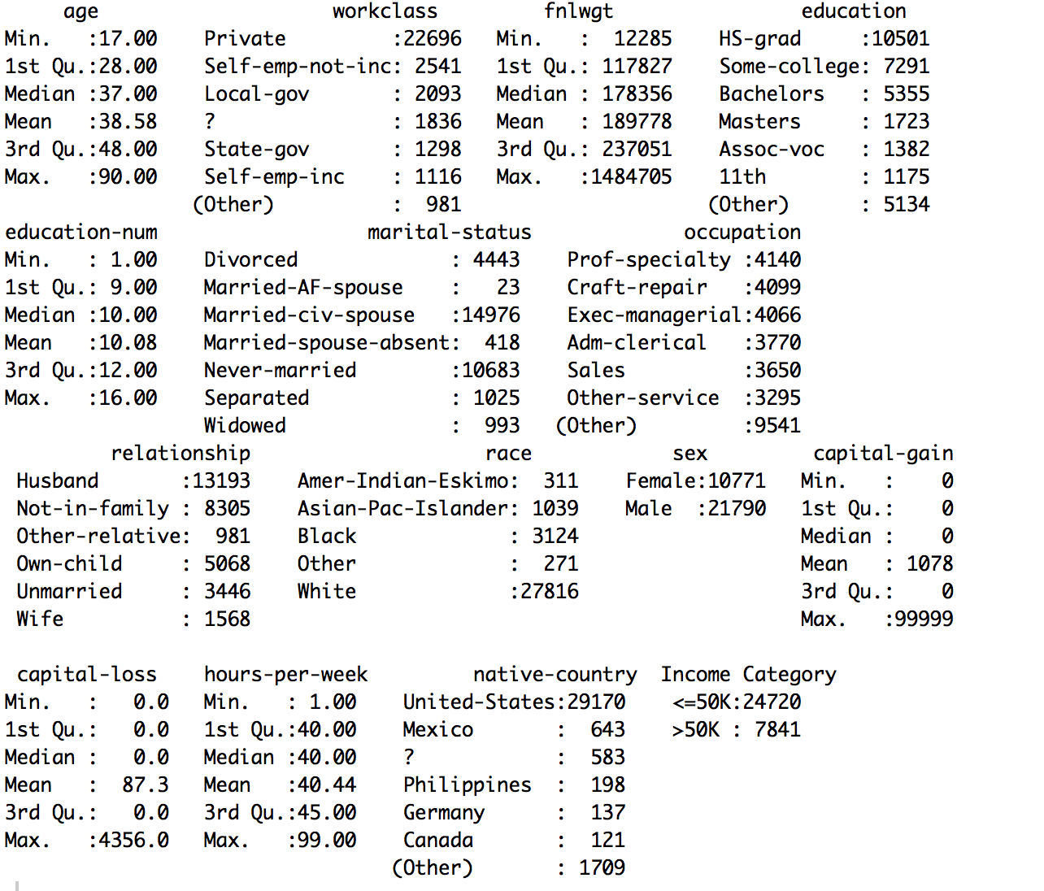
Inferential Statistics
From this summary statistics, '?’ Rows will be treated as “unknown”.

Slide 4
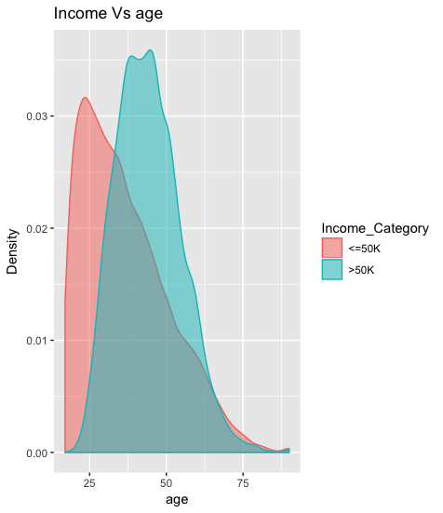
Exploratory Data Analysis (1/6)
Test-1: Income Vs. Age
From the graph, we could see that higher the age, higher will be the income

Slide 5
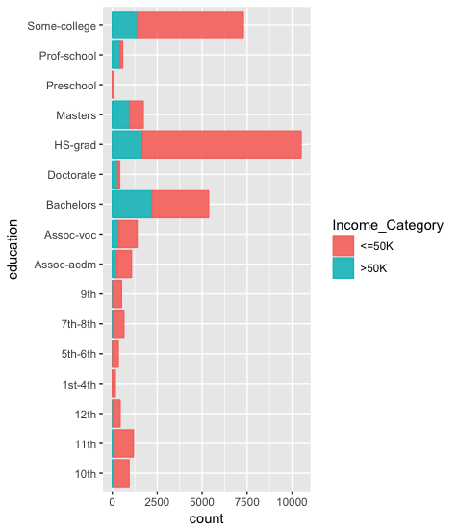
Exploratory Data Analysis (2/6)
Test-2: Income Vs. Education
From the graph, we could see that people who have completed their and hold any degree have higher chance of earning more than $50k

Slide 6
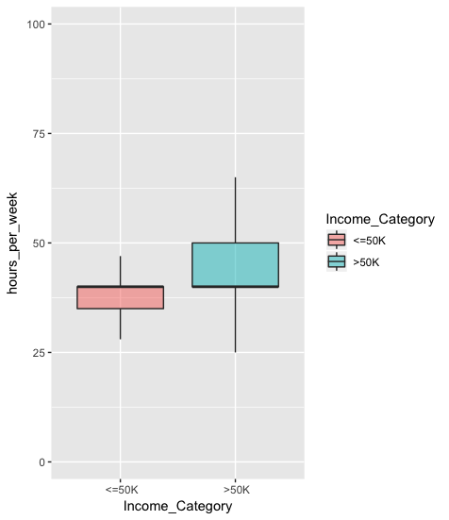
Exploratory Data Analysis (3/6)
Test-3: Income Vs. Hours per week
From the graph, it is evident that median no. of hours per week to achieve more than $50K is 45 hours. People who tend to work more than the median hours or lesser than the median hours are likely to earn less than $50K

Slide 7
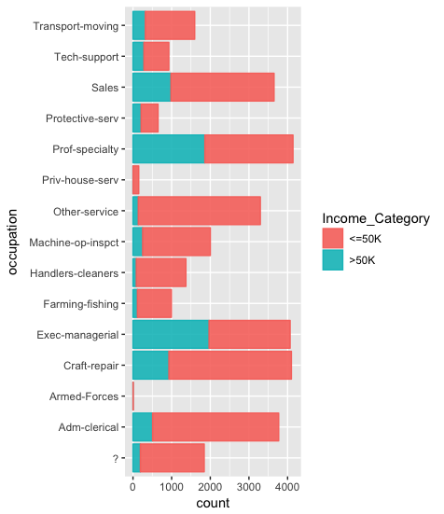
Exploratory Data Analysis (4/6)
Test-4: Income Vs. Occupation
Most of the occupation has a decent number of people earning more than $50K. The percentage of people earning more than $50K varies between 10 – 40% for each of the occupation

Slide 8
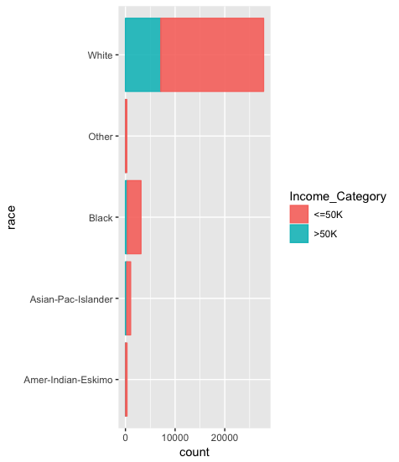
Exploratory Data Analysis (5/6)
Test-5: Income Vs. Race
The white race tends to take a lead in earning more than $50K than any other race.

Slide 9
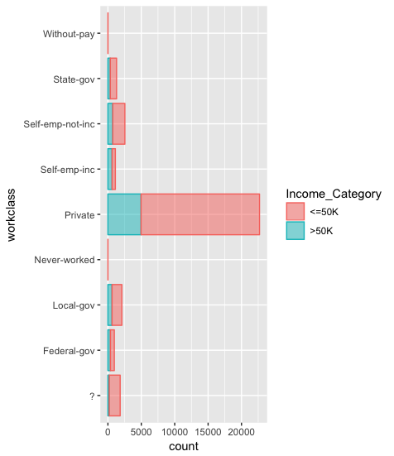
Exploratory Data Analysis (6/6)
Test-6: Income Vs. Workclass
We could find that most of the work force are employ-ed in private sector than compared to the other sector. ‘?’ is treated as separate sector, since we don’t have enough information to remove or treat this symbol. ‘?’ is tre-ated as a unknown sector

Slide 10
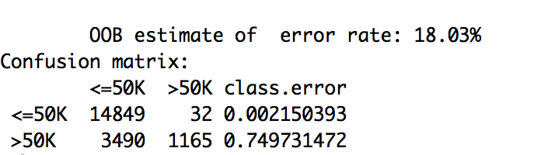
Models used for analysis – Random Forest
On running the random forest algorithm on the dataset, we get out of bag (OOB) error rate as 18.03%, which is fine.

Slide 11
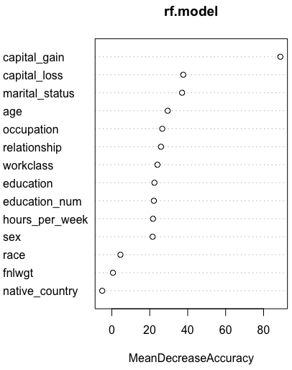
Models used for analysis – Random Forest
Variable Importance graph
From the graph, we could say that capital gain feature is contributing more to the model. We could also see that from feature sex to capital loss, all the features are contributing more or less equally to the model
This graph shows us the importance of the variable being used in the random forest

Slide 12
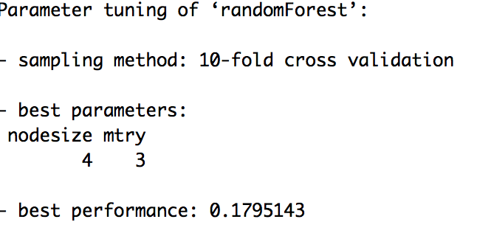
Models used for analysis – Random Forest
Tuning of Random Forest
After running the model with different mtry and node size parameter, we get optimized parameter value

Slide 13
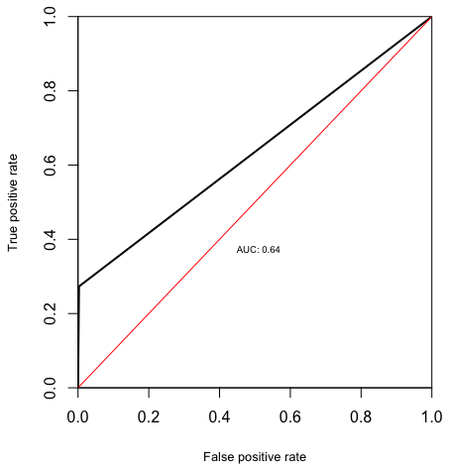
Models used for analysis – Random Forest
ROC Curve:

Slide 14
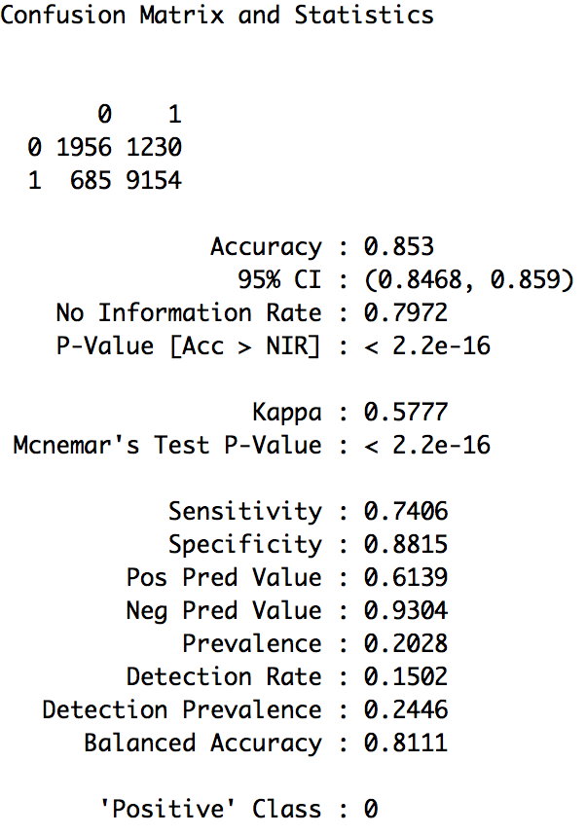
Models used for analysis – Logistic Regression
We got around 85% accuracy in predicting the income. The sensitivity and specificity has good percentage of accuracy.

Slide 15
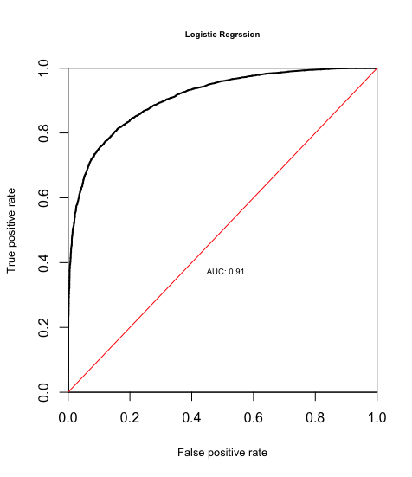
Models used for analysis – Logistic Regression
ROC Curve:

Slide 16
Conclusion
The people who are married and who hold a degree have a higher probability of earning more than $50,000

